Slide 1

Turning the Screws
Tools for Policyholders When Coverage and Exposure are Disputed

Slide 2
Discussion Topics
Policy Limits Demand
Hammer Letters
Insurance Fair Conduct Act (“IFCA”)
Covenant Judgments
Other Leverage Tools

Slide 3

Policy Limits

Slide 4

Policy Limits Demand (What is it?)

Slide 5
Policy Limits Demand (What is it?)
What is a Policy Limits Demand?
Letter sent by plaintiff’s counsel to defendant and insurer
Outlines facts, plaintiff’s injury, and liability
Demands insurer pay within/at policy limits to resolve matter

Slide 6
Policy Limits Demand (What are the parts?)
Components of Policy Limits Demand
Factual background
Damages/injuries
Liability analysis (w/ documentation/ case law)
Settlement demand w/ release
Deadline/ expiration of the demand

Slide 7
Policy Limits Demand (What is the effect?)
Effect of Policy Limits Demand
Create opportunity for insured to settle and avoid litigation costs and judgment
Triggers insurer duty to further evaluate claim for liability/ excess exposure
Pressure on defendant and insurer to resolve matter

Slide 8
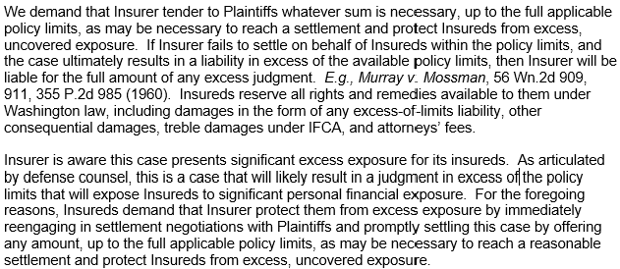
Policy Limits Demand (Excerpt Example)

Slide 9


Slide 10

Hammer Letters

Slide 11
Hammer Letter (What is it?)
What is a Hammer Letter?
Demand sent by insured to primary insurer
Pressures insurer to settle/ accept offer within policy limits (can be sent by plaintiff’s counsel directly to defendant’s insurer)

Slide 12
Hammer Letter (What is its purpose?)
What is its purpose?
Motivate insurer to settle
Protect insured from excess of limits, uncovered, liability exposure.

Slide 13
Hammer Letter (What are the components?)
Components of Hammer Letter
Introduction w/ clear demand
Factual background
Liability analysis (w/ docs and case cites)
Insurers’ conduct (WAC/CPA, bad faith, ignoring defense counsel)
Consequence (if insurer refuses to settle)
Deadline/expiration of demand

Slide 14
Hammer Letter (When to send?)
When to send a Hammer Letter
After valuation of the claim
After Plaintiff sends demand (outlining excess exposure/ demand within limits)
After mediation (where given opportunity to settle within limits)
After review of defense counsel reports (indicating excess liability/ personal liability exposure)

Slide 15
Hammer Letter is different than Hammer Clause
What is a Hammer Clause?
Coverage condition/ “consent to settle” clause
What is its purpose?
Allow insurer to cap its liability based on policy
E.g., Insured has opportunity to settle, rejects it, and continues defending. Policy language states all costs incurred after rejection could be excluded, split 50/50, 80/20, or other

Slide 16
Hammer Letter is different than Hammer Clause
Which policies may include Hammer Clauses?
Primary Policies: errors & omissions policies, directors and officers, and employment practices liability policies
Excess Policies: allows excess insurer to limit its liability if opportunity for insured or primary insurer to settle within primary limits and they refuse

Slide 17
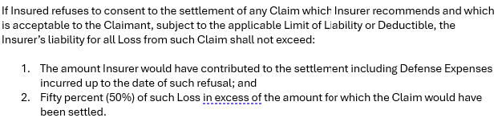
Hammer Letter is different than Hammer Clause (Example)

Slide 18

Insurance Fair Conduct Act (“IFCA”)
RCW 48.30.015

Slide 19
IFCA (What is it?)
What is an IFCA letter?
Demand letter sent to insurer
Outlines unreasonable denial of coverage or payment of benefits
Outlines basis for unreasonableness
Demands insurer resolve it

Slide 20
IFCA (What are the components?)
Components of IFCA Letter
Policy information
State insurer unreasonably denied coverage or payment of benefits
Describe unreasonable conduct/ denial
Detail damages suffered by insured
Send to insurer and Office of Insurance Commissioner at least 20 days before filing lawsuit which includes IFCA cause of action

Slide 21
IFCA (What are the components?)
Why and When to Send IFCA Letter
Notify insurer of intent to file suit
Comply with 20-day IFCA notice under RCW 48.30.015
Motivate insurer to engage in settlement discussions

Slide 22
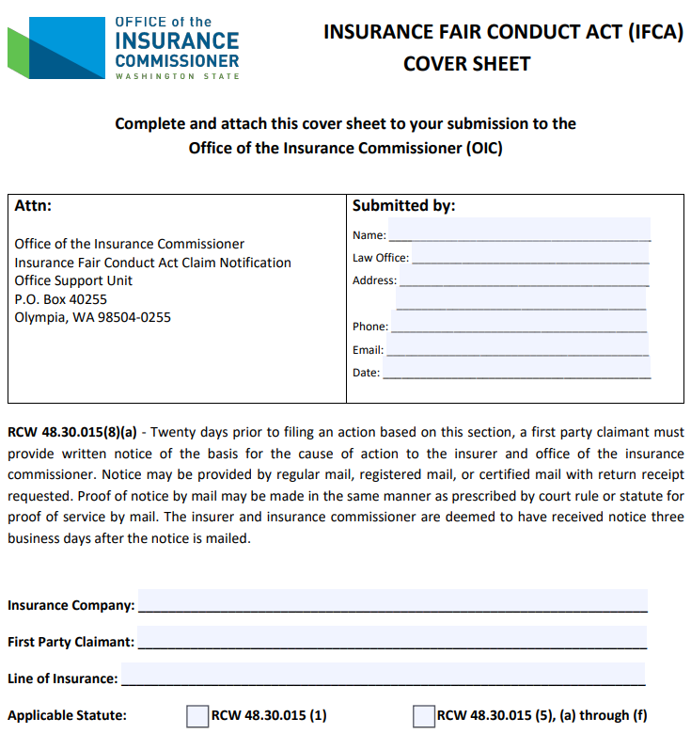
IFCA (IFCA Cover Sheet)

Slide 23
POLLING QUESTION
You need to provide _____ notice to the insurance company and the Washington State Office of the Insurance Commissioner before suing an insurance company under the Insurance Fair Conduct Act.
1 Day
20 Days
180 Days
365 Days

Slide 24
ℭ𝔬𝔳𝔢𝔫𝔞𝔫𝔱 𝔍𝔲𝔡𝔤𝔪𝔢𝔫𝔱
Stipulated Judgment, Settlement Agreement, and Covenant Not to Execute

