Slide 1
Broker Liability Refresher
Legal Exposure A
Legal Exposure B
Breach of contract and/or negligence in failing to carry out specific instructions. E.g., not procuring coverage that the insured expressly requested
Easier path for claimant
“Special Relationship”—A heightened duty to provide advice to a professional standard of care
Duration of relationship?
Compensation other than commission?
Written services agreement?
Representations from broker about services, expertise?
Knowledge that client is relying on that expertise?

Slide 2
Most Common Sources of Broker Liability Claims
Notifying insurers, especially under claims-made-and-reported policies and excess policies
Law is unforgiving
Widespread lack of awareness among insureds
Importance of notice of circumstance/potential claims
No Special Relationship showing needed
Notify the entire tower

Slide 3
Most Common Sources of Broker Liability Claims
Ensuring continuity of coverage under claims-made policies
Retroactive dates
“Tail”/extended reporting period

Slide 4
Most Common Sources of Broker Liability Claims
Ensuring that coverage is bound and policies are issued as intended
The “fog of negotiation”
Creating a clear record of what is being placed—potential claims for reformation of policies
Delay in issuing policies
Importance of checking policies
No Special Relationship required

Slide 5
Most Common Sources of Broker Liability Claims
Special Relationship Cases:
Failing to evaluate the client’s exposures and recommend appropriate coverages and limits
Failure to notify the insured of changes to coverage at renewal
Others: Issuance of COI’s, especially post-T-Mobile

Slide 6

The Dream Team
Lawyers
Knowledge of case law and WA statutes
Letterhead—escalation at the right time
Brokers
Overall insurance savvy—what “should” the result be?
Relationships with adjusters—when is the right time for a “lawyer letter”?
Business relationships with insurers and TPAs
Knowledge of the insurance market—what is doable and consequences of payments and coverage disputes

Slide 7

Preserving the Attorney-Client Privilege
Important that communications involving insured, coverage counsel, and broker be protected from discovery
Attorney-client privilege is not automatic—to the contrary, start from the assumption that broker involvement destroys the privilege
Strategies for protecting the privilege:
Formalizing broker’s role as a consulting expert to counsel
Beware email musing about coverage issues
No “crown jewel” memos to the broker

Slide 8

Frank Cordell
Partner
206-467-6477
fcordell@gordontilden.com
Susannah Carr
Managing Partner
206-467-6477
scarr@gordontilden.com

Slide 9
Turning Uninsured Property Losses Into Legal Recoveries
Creative Strategies for Maximizing Recovery

Slide 10
Learning Objectives
Identify why property coverage gaps occur and how to recognize them early.
Evaluate potential third-party claims when coverage falls short.
Learn how to coordinate with subrogation counsel or carriers.
Understand how to use assignments as a bridge to new insurance recoveries.

Slide 11

Uninsured Losses
How many of you have seen a claim where coverage didn’t fully respond—and the insured assumed that was the end of the road?
Think of a claim you’ve handled where the carrier paid something—but far less than the actual cost. What created that gap?

Slide 12

The Coverage Gap Problem
Why Property Insurance Often Falls Short:
Policy limits vs. total replacement cost (inflation, code upgrades, soft costs).
Exclusions for workmanship, design, or maintenance defects.
Coverage limited to “direct physical loss” — not loss of value or delayed repair.
Business interruption/extra expense limits expiring before work completes.

Slide 13
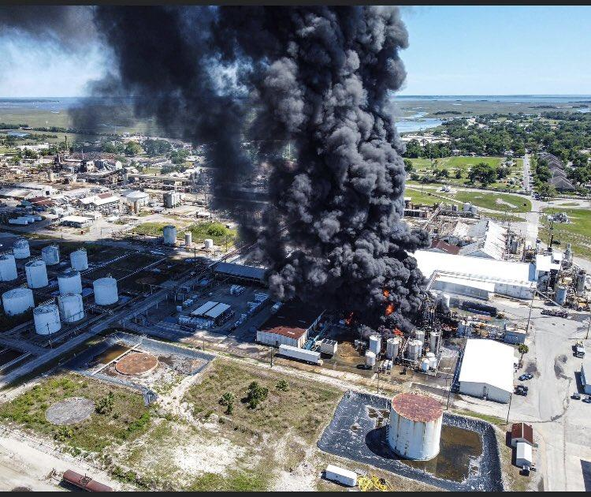
Real World Examples
Examples:
Condominium Water Intrusion.
Warehouse Roof Collapse.
Toxic Fume Contamination at a Hotel.
Manufacturing Plant Fire.
Frozen Pipes at a Home.
When coverage ends, your recovery options shouldn’t. That’s where liability investigation begins.

Slide 14

Identifying Viable Third-Party Claims for Uninsured Losses
Early forensic work: retain engineers and materials experts.
Compare as-built conditions with plans/specs.
Trace the causal chain—what party’s conduct or product contributed?
Identify who was on site and when (subs, vendors, manufacturers).
Pro Tip: Obtain documents, including contracts, change orders, insurance certificates, policies, etc.

Slide 15
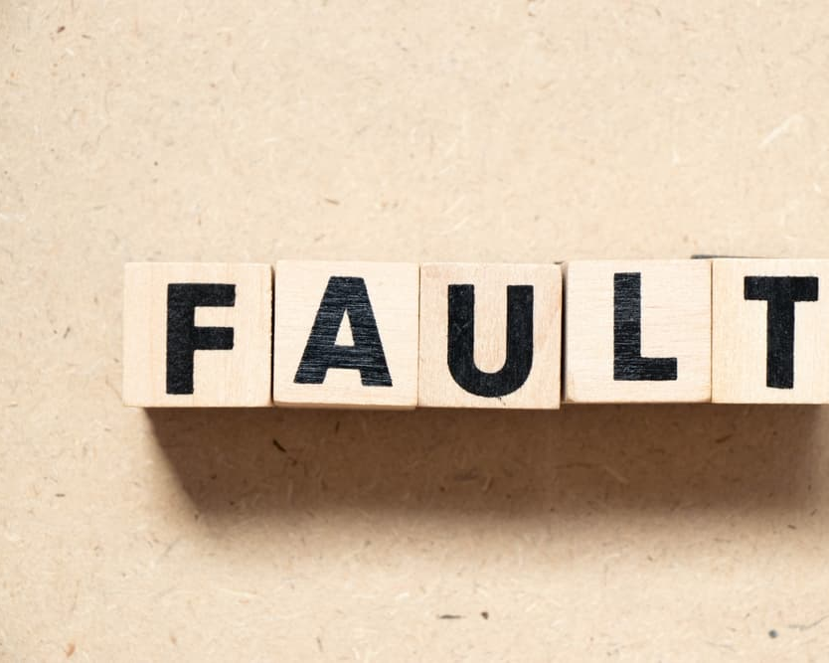
Common At-Fault Parties
Contractors/Subcontractors: negligent installation, failure to follow specs.
Architects/Engineers: design defects, improper materials selection.
Manufacturers/Suppliers: product failure or incompatibility.
Developers/Owners: failure to supervise or coordinate work.

Slide 16

Evaluating Legal Theories
Negligence: unsafe design or installation leading to property damage.
Breach of Contract: failure to perform per plans/specs; implied duty of workmanship.
Breach of Warranty: express or implied (fitness, merchantability, durability).
Product Liability: defective components causing downstream loss.
Statutory Claims: consumer protection, product liability act.
Contribution/Indemnity: contractual or equitable.
Pro Tip: Evaluate statutes of limitation/repose—act early.

Slide 17
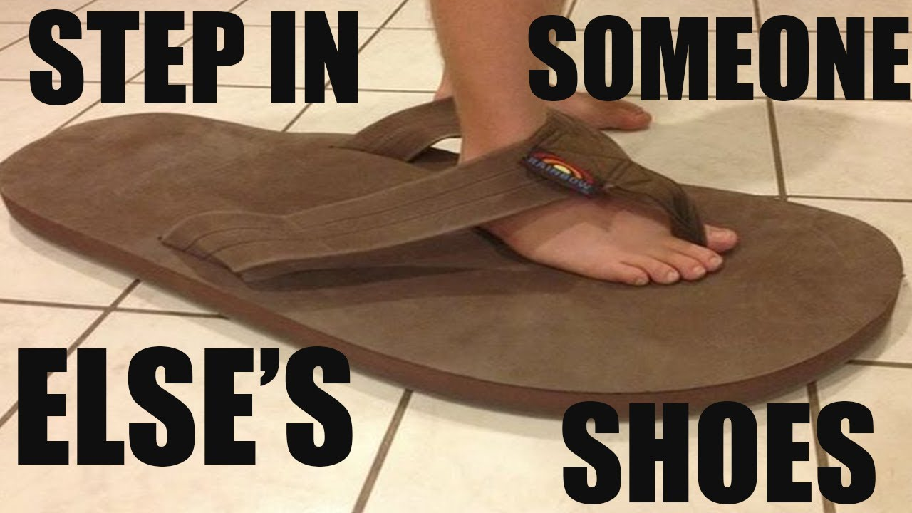
Subrogation Basics
Even if your client’s insurer is pursuing subrogation, you can often coordinate efforts to improve both recoveries.
Definition and purpose of subrogation
Subrogation = insurer “steps into the shoes” of the insured.
Arises after insurer pays a loss.
Two types
Equitable (automatic).
Contractual subrogation (policy language and assignments).
Subrogation vs. Reimbursement.

Slide 18
Subrogation Basics
Common Scenarios
Property insurer pursuing negligent contractor.
Auto and/or health insurer pursuing tortfeasor.
Limitations
Anti-subrogation rule (insurer cannot subrogate against its own insured).
Waivers of subrogation.
Priority of recovery.
The Made Whole Doctrine
Thiringer v. American Motors Ins. Co., 91 Wn.2d 215 (1978)
Daniels v. State Farm Mut. Auto. Ins. Co., 193 Wn.2d 563 (2019)
Group Health Coop. v. Coon, 193 Wn.2d 841 (2019)

Slide 19
Aligning with Your Insurer’s Subrogation Efforts
Even if your client’s insurer is pursuing subrogation, you can often coordinate efforts to improve both recoveries.
The first step is to coordinate with the insurer’s subrogation team:
Know who the subrogation lawyers are.
Request status updates from the subrogation lawyers.
Participate in joint examinations.
Ensure your uninsured losses are part of the damages model.
Piggyback on the insurer’s discovery and expert work.
Negotiate cost-sharing: experts, mediations, depositions.

Slide 20
Aligning with Your Insurer’s Subrogation Efforts
Potential Conflicts Abound
Counsel representing both the insurer and insured without informed consent—creating divided loyalties.
Subrogation counsel pursuing only the insurer’s covered loss while ignoring the insured’s uninsured damages.
Competing interests among the insured, primary carrier, excess carriers, and other insurers with overlapping coverage layers.
Divergent settlement objectives—insurers often seek an early, discounted resolution, while the insured aims for full recovery.
Expert opinions that support one party’s theory of liability but undermine the other’s.
The insured pursuing a separate coverage or bad-faith claim against one of the subrogating insurers.
Best Practices to Avoid and Manage Conflicts
Use separate engagement letters clearly identifying each client and scope of representation.
Address allocation of recoveries, litigation strategy, and expert coordination at the outset.
Maintain open communication and ensure the insured retains an independent voice in all settlement discussions.
Joint Prosecution Agreements
What are they, and why do you need one?
Sharing litigation costs.
Allocating the subrogation recovery.
Real world examples.

Slide 21

Strategic Use of Assignments
What an Assignment of Claims Is
A transfer of legal rights from one party (assignor) to another (assignee).
Common in settlements where at-fault party has insufficient assets or insurance to cover all the damages.
Used in covenant judgment frameworks (Wood v. Milionis; Bird v. Best Plumbing).
Turning Assignments into Recovery Tools
Obtain assignment of the contractor’s rights against its insurer or subcontractors.
Use IFCA/CPA leverage to enhance value against insurer assignments.
Case example: HOA obtains assignment from general contractor, recovers from subcontractor’s insurer.

Slide 22
Recap and Core Takeaways
Coverage gaps are common—anticipate and quantify them early.
Liability investigation is key to unlocking uninsured recovery.
Coordination with subrogation can multiply recovery value.
Assignments help bridge the gap by turning partial recoveries into full recoveries.

Slide 23
Polling Questions
Q. What is subrogation?
a. The right of an insured to demand immediate payment of policy limits when a loss occurs.
b. The process by which an insurer, after paying a loss, acquires the insured's rights to pursue recovery against a responsible third party.
c. A clause that requires an insurer to provide coverage regardless of exclusions in the policy.
d. The obligation of an insurance broker to act in the best interest of the insured when placing coverage.
Q. What is an assignment of rights?
a. A clause in an insurance policy that requires the insured to cooperate with the insurer’s investigation of a claim.
b. The transfer of an insured's legal rights or claims under an insurance policy to another party, such as after payment or settlement.
c. The obligation of an insurer to defend the insured against all lawsuits that may be filed.
d. The process by which an insurer seeks reimbursement from another insurer for shared liability.

Slide 24


Brendan Winslow-Nason
Partner
bwinslow-nason@gordontilden.com
John Cadagan
Partner
jcadagan@gordontilden.com

Slide 25
Navigating Large Insurance Dynamics in Mediation

Slide 26
Overview
Explaining the Mediation Process to Clients
Preparing for Mediation
The Mediation Process and What’s Important

Slide 27
Explaining the Mediation Process to Clients
Mediation is Consensual and Voluntary
Mediation v. Arbitration
Mediations are Confidential
Rule of Evidence 408
RCW 7.07
Confidentiality Agreements
Strategic Advantages to Mediation

Slide 28
Preparing for Mediation
When to Schedule Mediation
Pre- or Post-Suit?
Discovery?
Pending Dispositive Motion?
Selecting a Mediator
Facilitators v. Evaluators
Mediator Bias
Work Ethic
Mediation Submissions
Public v. Private Submissions

Slide 29
The Mediation Process
Joint Opening Sessions
Necessary or Outdated?
Reading the Room
Opening Gambit
Who goes first?
Opening Offer: why so high?

Slide 30
The Mediation Process
Now what?
Process of Adjusting Expectations
Sending Messages
Participation of Principals, Attorneys, & Experts
Non-monetary Terms and Solutions
Involving Insurers
Settlement Agreements

Slide 31


Dale Kingman
Partner
dkingman@gordontilden.com
Dan Bentson
Partner
dbentson@gordontilden.com

Slide 32
Underwater and on Fire: Climate Change and the Future of Insurance
Notes:
KASEY

Slide 33
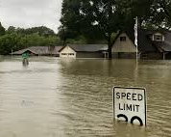
Recent Climate Change Developments
More Frequent Weather & Fire Events
Fire season is longer; fires are more frequent
Number of hurricanes increasing in the North Atlantic
Drought is more frequent
Flooding is more frequent
Notes:
LIAM

Slide 34
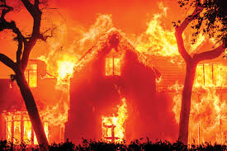
Recent Climate Change Developments
More Severe Weather & Fire Events
Burned areas from fires are larger
Hurricanes form more quickly and their intensity has increased
Droughts last longer and are more severe
Flooding covers more area, and more people have moved to flood-prone locations
Notes:
LIAM

Slide 35
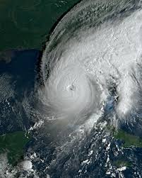
Recent Climate Change Developments
Weather & Fire Events Concentrated in Specific Areas
Areas of concentration can be large (e.g., CA fires)
The same locations may be impacted repeatedly (sometimes annually) by fire, drought, flood, and hurricanes
Notes:
LIAM

Slide 36
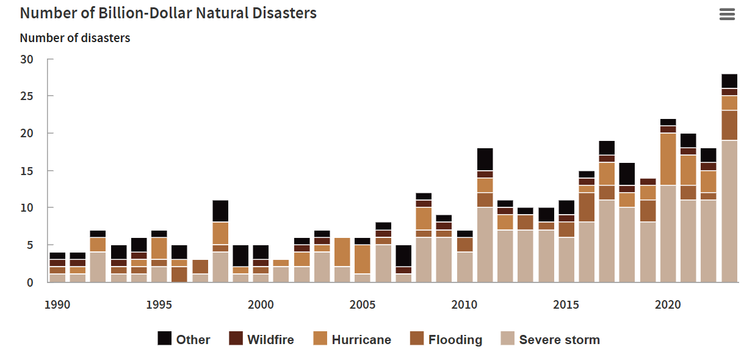
Congressional Budget Office 2024 Report
Notes:
LIAM

Slide 37
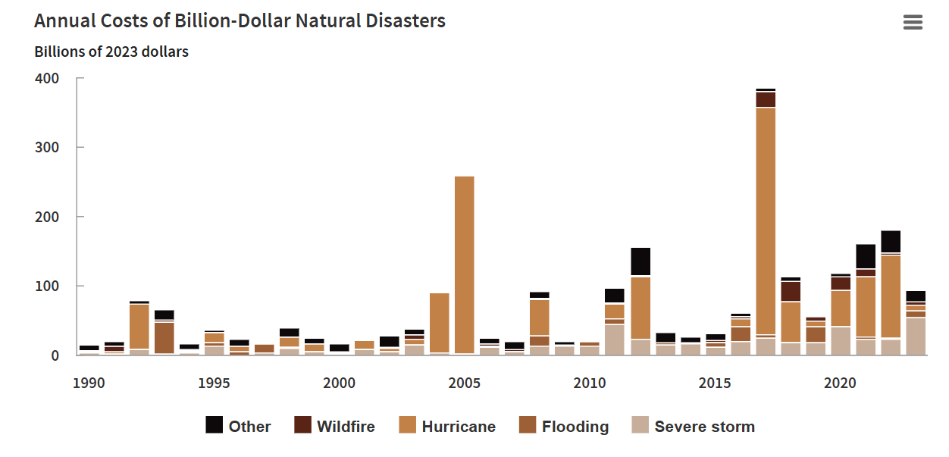
Congressional Budget Office 2024 Report
Notes:
LIAM

Slide 38
True or False?
Weather and climate related disasters are becoming more frequent and more severe.

Slide 39
Impacts on the Insurance Industry: Risk Assessment
Development on newer risk assessment tools accounting for climate impacts
Proprietary/not aggregated
Some suggestion that this information should be gathered in one place and shared with the government
More than half of insurers have developed climate-related risk and investment management policies
WA, OR, CA: 2024 climate “stress test”
Notes:
KASEY

Slide 40
Impacts on the Insurance Industry: Risk Assessment
Third-party coverage
GL, D&O, and professional liability
Businesses face increased litigation/liability for climate-related harms
Increased insurance claims as a result
“Bluelining”
Withdrawing from markets that are perceived to pose a high risk of climate disasters
Greater impact on already vulnerable populations
Notes:
KASEY

Slide 41
Impacts on the Insurance Industry: Premiums
Premiums are increasing for property coverages
Example: Homeowners’ premiums increased 30% (13% adjusted for inflation) between 2020 and 2023
Particularly true in “hot spots”
GL, D&O, and professional liability
New coverage = higher cost
Possible increase in overall cost for standard coverage
The impact on health and life insurance premiums is not yet clear
Notes:
KASEY

Slide 42
Impacts on the Insurance Industry: Availability of Coverage
Primarily impacts first-party property coverage
Treasury Department: Higher non-renewals in areas with higher expected losses from climate-related perils
Examples (which also may include regulatory impact)
Farmers left the Florida homeowners’ market in 2023
Seven out of 12 major carriers are leaving California or reducing coverages available
Notes:
KASEY

Slide 43
Impacts on the Insurance Industry: Availability of Coverage
Chain Reaction
No money to rebuild
Default
No collateral for lender
Notes:
KASEY

Slide 44
Impacts on Specific Coverages: Some Examples
Property: Increased cost of repair
Shortage of labor & supplies
Prices increase with demand
Liability: New liabilities = more claims
Some claims are similar to asbestos claims
“Greenwashing”
Failing to account for climate risk
Life/health/long-term care: Impacts on morbidity and mortality
Example: Per the CDC, heat-related hospitalizations increased 88% in CA, NV, and AZ in 2023 as compared to 2018-2022
Notes:
KASEY

Slide 45
True or False?
The frequency and severity of weather and climate related losses likely will have no impact on the insurance industry.

Slide 46
What the Future May Hold
Even higher premiums
More/different exclusions
But also: New climate-related coverages
Apportionment of risks between public and private sectors
More tools to assess climate-related risks
Financial incentives for policyholders that engage in activities that reduce the likelihood of claims
Increased risk of insurers becoming insolvent
Notes:
LIAM

Slide 47
What the Future May Hold
Insurance less available in “hot spots”
Policyholders taking on more risk
Sometimes unknown risk due to underinsurance
1 in 13 homeowners do not have insurance
More stringent building codes to reduce risk
Monitoring of climate-stress on individuals through sensors and “wearables”
More use of “insurers of last resort” programs offered by states
Washington FAIR (Fair Access to Insurance Requirements) Plan
Notes:
LIAM

Slide 48
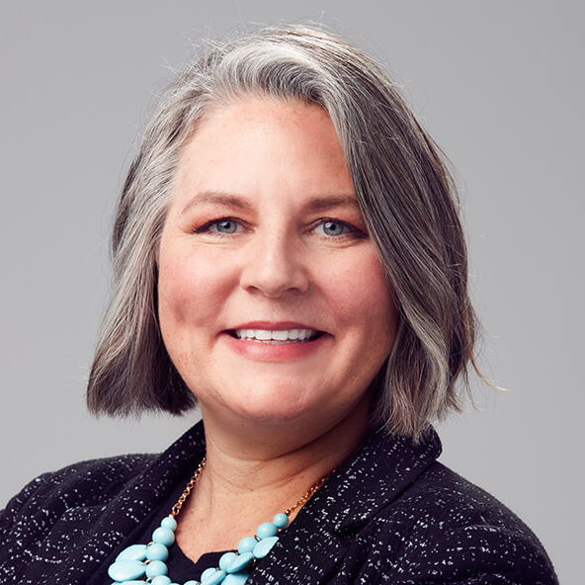

Kasey Huebner
ParTNER
206.805.6641
khuebner@gordontilden.com
Liam McKeegan
Associate
509.272.2848
lmckeegan@gordontilden.com
Notes:
KASEY

